Slide 1
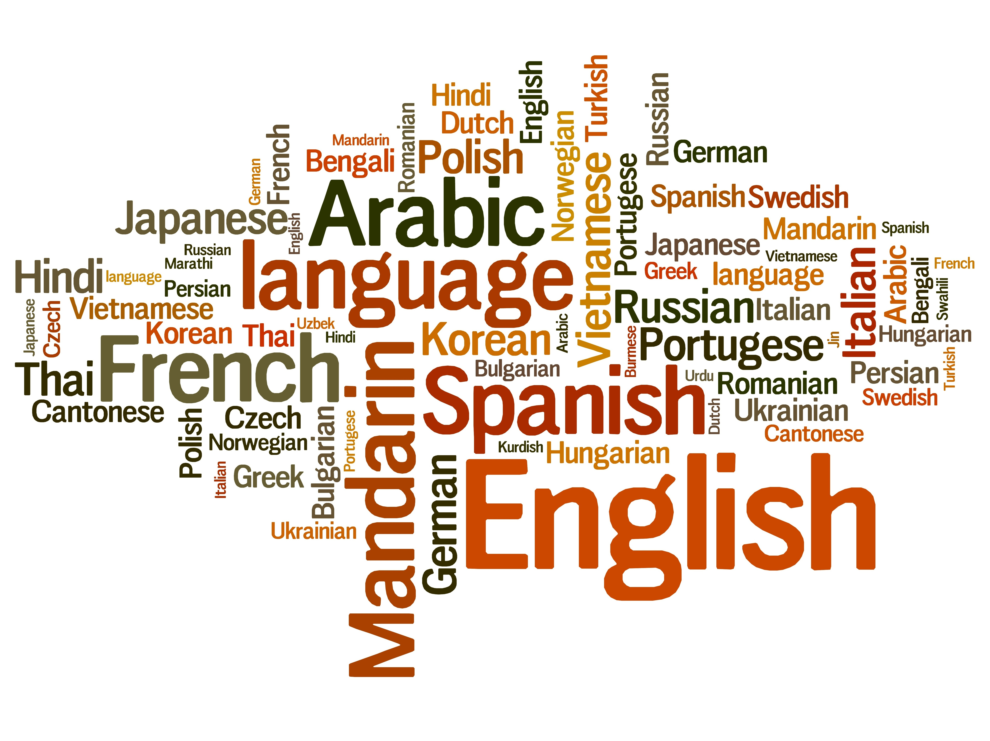
Dive Deeper into Present-Day English
Vol.2 -English around The World-
Composed By: Hayato Ishida
For Japanese version, click here
Updated On: 16 July 2024

Slide 2

About Me
Accounts
GitHub: @hayat01sh1da
X: @hayat01sh1da
LinkedIn: @hayat01sh1da
Speaker Deck: @hayat01sh1da
Docswell: @hayat01sh1da
Occupation: Software Engineer
Things I Am Into
Linguistics
Singing at Karaoke
Listening to Music
Watching Movies
Cat Feeding

Slide 3
Licences / Certifications
English
TOEIC® Listening & Reading 915: Certified on December 2019
Engineering
Information Security Management: Certified on November 2017
Applied Information Technology Engineer: Certified on June 2017
Fundamental Information Technology Engineer: Certified on November 2016
IT Passport: Certified on April 2016
Others
Abacus 2nd Class: Certified on June 2002
Mental Arithmetic 3rd Class: Certified on February 2001

Slide 4
Skill Stack
Languages
Japanese: Native Proficiency
English: Full professional Proficiency
Development
Backend: Ruby(Ruby on Rails), Python
Frontend: TypeScript + React.js, TypeScript +Vue.js
Database: MySQL, PostgreSQL, MongoDB
Architecture: Monolith, Modular Monolith
Hosting: AWS ESK
Versioning: Git, GitHub
CI/CD: GitHub Actions, ArgoCD
Monitoring: Datadog, Sentry

Slide 5
Work Histories
Period | Genre | Position | Jobs
Aug 2021 - Present | Saas(Educational Service) | Software Engineer | Backend Development Frontend Development CI/CD Maintenance Weekly Release Manager Troubleshooting Documentation Technical Debt Resolution Tech Blog Entries LT Speaker
Feb 2020 - Dec 2020 | SaaS(Chatbot Platform) | Backend Engineer | Backend Development Documentation Technical Debt Resolution Inspection of Alternative API

Slide 6
Work Histories
Period | Genre | Position | Jobs
Jun 2018 - Jan 2020 | Contract-basis Developer | Software Engineer | Backend Development Frontend Development Troubleshooting Quality Assurance Tech Blog Entries
Apr 2016 - Jan 2018 | System Engineering Service | System Engineer | Corporate Account Admin Windows Server Maintenance Security Admin Assistant Internationalisation / Localisation

Slide 7
International-Exchange Activities
Activities in University
English Linguistics Seminar(Focusing on Mass Media English)
International-Exchange Clubs(The 2nd Year)
International-Exchange Programmes conducted by Japan Cabinet Office(2013 - 2016)
Japanese Linguistics Course(The Final Year)
Overseas Life Experience
Working Holiday in Australia(April 2014 - March 2015)
Language School for 1 month in Sydney
Work for 6 Months in Hamilton Island Resort
Volunteering for 1 Month as Assistant Teacher of Japanese Language at St Ives High School in NSW
Other Activities
Keep Everyday Journal in English (April 2014 - Present)
Sunrise Toastmasters Club(February 2017 - March 2018)
Vital Japan(January 2018 - July 2019, October 2022 - February 2023)
Self Learning and Training of English Language
Participation Ruby-Related Tech Conferences

Slide 8
Goals of This Series
To know how deep English Language is
Not simply a communication tool
To know your own language by knowing another
"He who knows no foreign languages knows nothing of his own." by Johann Wolfgang von Goethe
To pursue the essence that does not instantly but work later on
Something which you think is meaningless has something genuine

Slide 9
Agenda
Various 'English' around the World
British English vs. American English
Summary
References

Slide 10
1. Various 'English' around the World

Slide 11
1. Various 'English' around the World
Present-Day English Can Be Categorised to 5 Genres.

Slide 12
1. Various 'English' around the World
English in Natively English-Speaking Countries
British English(British English / Queen's English)
Anglo Saxon established England and English language who immigrated to Great Britain in A.D. 450
The name Angle is inscribed in the name of country and language
England < Englaland = Angle's Land
English < Englisc = Angle's Language

Slide 13
1. Various 'English' around the World
English in Natively English-Speaking Countries
American English / President's English
Originates from Middle English in the 17 Century when William Shakespeare and John Milton gained their fame
Arrived from Britain ~ the coast of the Atlantic to the North American continent
The politically and linguistically strong movements promoted the distinctive development and evolution after the independence of the United Kingdom in the 18th century

Slide 14
1. Various 'English' around the World
English in Natively English-Speaking Countries
Canadian English
European immigrants began to dwell in the East Canada on the coast of the Atlantic released by Treaty of Paris in 1763
The American Revolution from 1775 to 1783 brought a large number of American immigrants
The Industry Revolution in the 19th century brought British immigrants
The nation consists of immigrants all over the world and is counted as an ethically diverse state
The language conflicts between American English as the first comer and British
English as the second comer influences linguistic features of Canadian English

Slide 15
1. Various 'English' around the World
English in Natively English-Speaking Countries
Australian English / Aussie English
Originates from the English brought by immigrants from the Southern East Britain
Basically inherits vocabulary and grammar of British English
exc. inquire > enquire, program > programme, labor > labour
Countless number of slang
e.g., G'day, Aussie, Brissie, Tassie, fridge, veggies, sunnies etc.

Slide 16
1. Various 'English' around the World
English in Natively English-Speaking Countries
New Zealand English / Kiwi English
The indigenous Maori ceded their dominion to the British government in 1840
British people started immigration since then
Basically inherits vocabulary and grammar of British English
Regularisation of irregular inflections caused by Analogy
e.g., roofs > rooves, wharfs > wharves
Words whose suffix is -ize in American English ends with -ise as Australian English
e.g., realise, initialise
Loan Words from Maori Vocabulary

Slide 17
1. Various 'English' around the World
English spoken as the Official or Second Language
Spoken in the countries below which used to be plantations of the British Empire
India
Sri Lanka
Kenia
Tanzania
Singapore
The Philippines
Hong Kong
etc.

Slide 18
1. Various 'English' around the World
Pidgin English
Concise English only for the sake of trades and simple communications
Developed among African countries, South Pacific countries and the regions along the coast of the Caribbean Sea which traded with Britain
Mixture of English and indigenous languages
Pidgin is Chinese from of business
Ambiguous distinction between /p/ and /b/ made /b/ pronounced as /p/
The last /s/ dropped

Slide 19
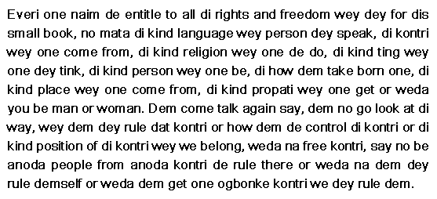
1. Various 'English' around the World
Pidgin English
Pidgin English | Standard English
gude | good day = hello
laik | like
nau | now
skulboi | schoolboy
guttaim | good time = peace

Slide 20
1. Various 'English' around the World
Creole English
Indigenised Pidgin English became the mother tongue
Spoken in various everyday scenes different from Pidgin English spoken only for the sake of trades and concise communications
Richer vocabulary and more complicated grammar
This change is called creolization

Slide 21
1. Various 'English' around the World
Ethically Specific English in English-Speaking Countries
English spoken by people of colour in America is a good example
Developed as a distinctive English because of its large number of population
Use of basic words
Specific grammar different from that of the standard English
Double Denial(used to express strong affirmation in the standard English)
Double Comparison
Omission of articles and propositions

Slide 22
2. British English vs. American English

Slide 23
2. British English vs. American English
The Same Word, Different Meanings
Words | British English | American English
corn | grains | maise
first floor | the second lowest floor | the lowest floor
rubber | eraser | condom
pants | under pants | trousers
chips | French fried | potato crisp

Slide 24
2. British English vs. American English
Different Words, the Same Meaning
British English | American English
lift | elevator
luggage | baggage
lorry | truck
biscuit | cookie
mobile | cell(celluar)
petrol | gasoline
single ticket | one-way ticket
return ticket | round-trip ticket
sweet(s) | candy
CV(curriculum vitae) | Resume

Slide 25
2. British English vs. American English
Different Words, the Same Meaning
British English | American English
shop | store
flat | apartment
tube / underground | subway
pavement | sidewalk
wash basin | sink
film / cinema | movie
fun fair | amusement park
graduation ceremony | commencement
queue | line
gaol | jail

Slide 26
2. British English vs. American English
The Same Word, Different Spellings
British English | American English
colour | color
cheque | check
centre | center
theatre | theater
omelette | omelet
organise | organize
grey | gray

Slide 27
3. Summary

Slide 28
3. Summary
Present-Day English can be categorised 5 genres.
English spoken in Natively English-Speaking Countries
English spoken as the Official or Second Language
Pidgin English
Creole English
Ethically Specific English in English-Speaking Countries: English of People of Colour
The following differences are observed between British English and American English.
The Same Word, Different Meanings
Different Words, the Same Meaning
The Same Word, Different Spellings

Slide 29
4. References

Slide 30
4. References
Kiyoaki Kikuchi・Kazutomo Karasawa・Ryuichi Hotta・Yasuyuki Kaizuka, 英語
史：現代英語の特質を求めて-多文化性と国際性-, Osaka, 関西人文科学出版会, 2009
Kiyoaki Kikuchi・Kazutomo Karasawa ・Takeshi Koike・ Ryuichi Hotta ・Kazuki Fukuda・ Yasuyuki Kaizuka ・Takeshi Matsuzaki, 英語学：現代英語をより深く知る ために-現代英語の諸相と英語学術語解説-, Osaka, 浪漫書房, 2008
Canadian English – THE CANADIAN ENCYCLOPEDIA
Last Accessed On: 19 October 2021
Nigerian Pidgin English - LM Languages
Last Accessed On: 18 October 2021
A guide to Australian English (and everything you need to know about the
Aussies!) - Lingoda
Last Accessed On: 18 October 2021
NEW ZEALAND ENGLISH - Encyclopedia.com
Last Accessed On: 18 October 2021

Slide 31
EOD

